Slide 1

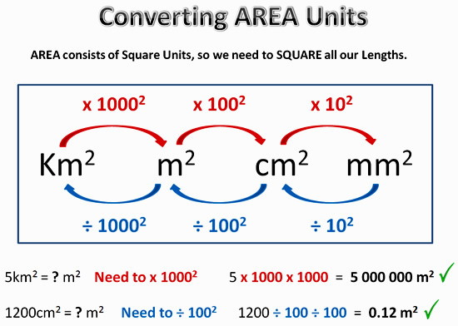
My Measurement Interactive Notebook
Name
Class
Teacher Mr Evans
Term 3 Semester 2
1

Slide 2
Contents
Glossary or Formula Page
Page
Date
Description
2
3

Slide 3
Tasks
24
7
30
Essential Question
Questions
Notes
Summary
6
7

Slide 4
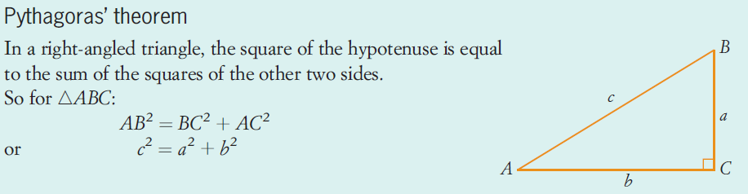
24
7
30
Date
Applying Pythagorus’ Theorem
EQ – How can Pythagorus’ Theorem be used to solve problems with triangles?
What is Pythagorus’ Theorem?
5

Slide 5
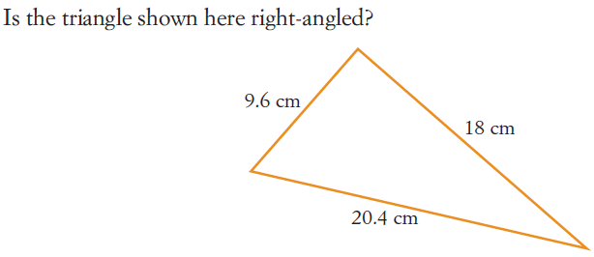
24
7
30
Date
Applying Pythagorus’ Theorem
EQ – How can Pythagorus’ Theorem be used to solve problems with triangles?
What is Pythagorus’ Theorem?
How do we use Pythagorus’ Theorem to determine whether a triangle is a right angled triangle?
5

Slide 6
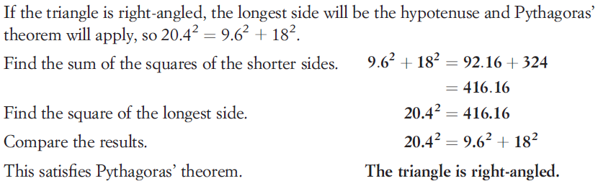
24
7
30
Date
Applying Pythagorus’ Theorem
EQ – How can Pythagorus’ Theorem be used to solve problems with triangles?
5

Slide 7
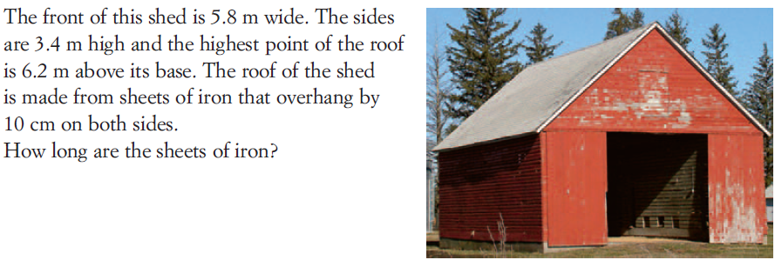
24
7
30
Date
Applying Pythagorus’ Theorem
EQ – How can Pythagorus’ Theorem be used to solve problems with triangles?
How does Pythagorus’ Theorem help us solve other problems?
5

Slide 8
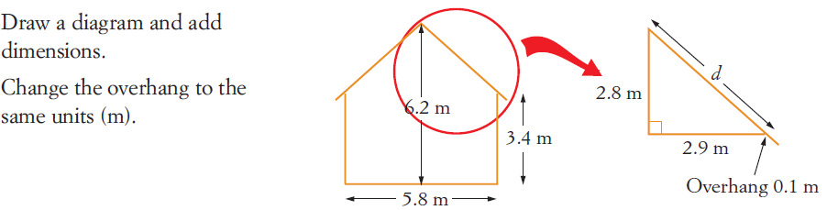
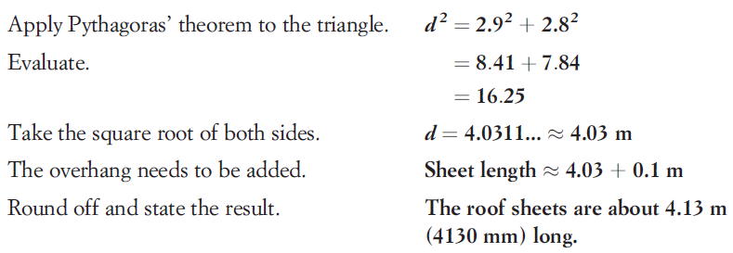
24
7
30
Date
Applying Pythagorus’ Theorem
EQ – How can Pythagorus’ Theorem be used to solve problems with triangles?
How does Pythagorus’ Theorem help us solve other problems?
5

Slide 9
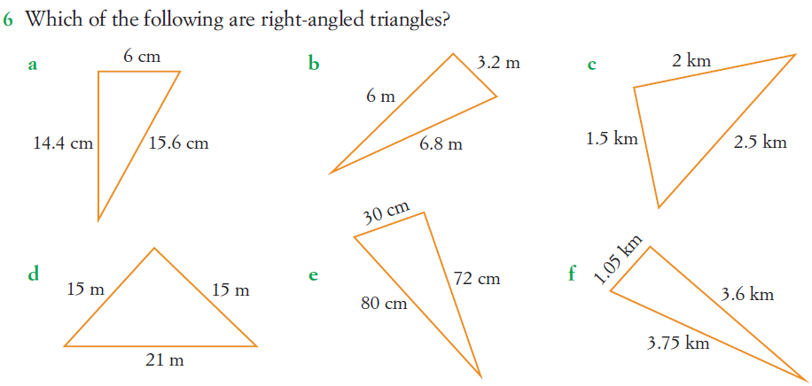
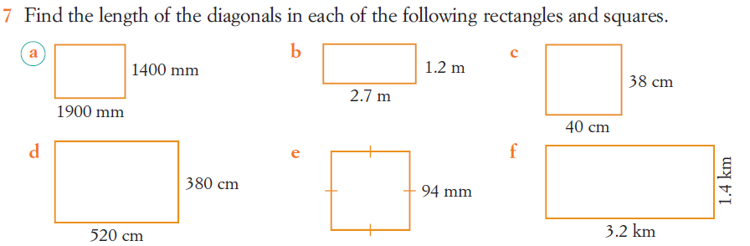
Questions

Slide 10
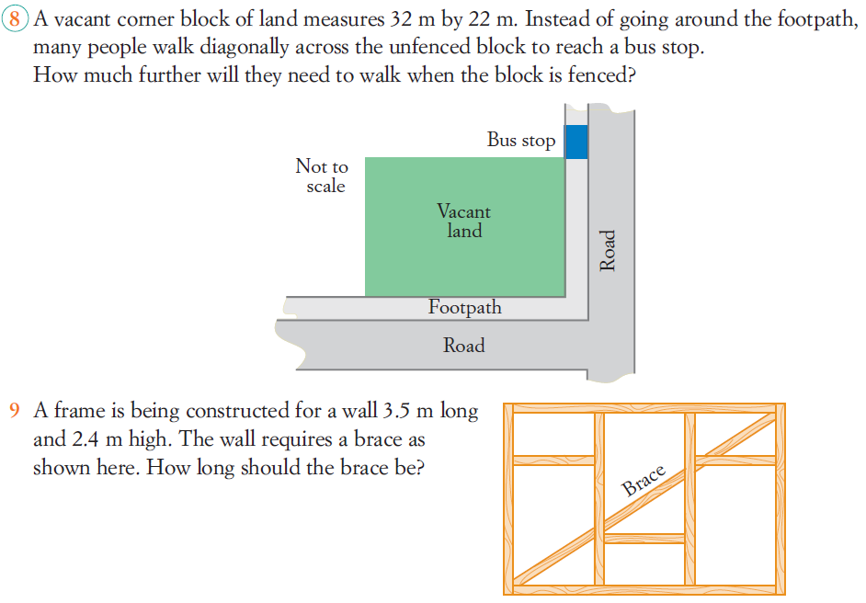
Questions

Slide 11
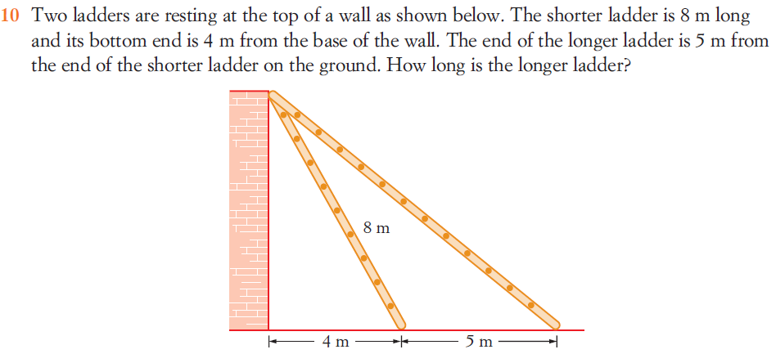
Questions

Slide 12
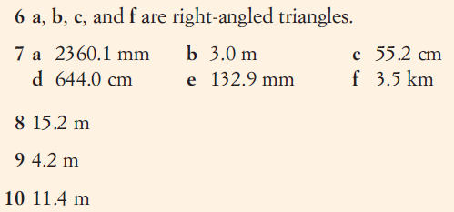

Answers

Slide 13
Notes Review
24, 7 ,30
Date
Title
Essential question
Notes complete
Notes complete with colour and diagrams
Questions completed
Contents page filed in
Formula page filled in

Slide 14
Homework
Review your notes and write a summary answering the essential question.

